Slide 1

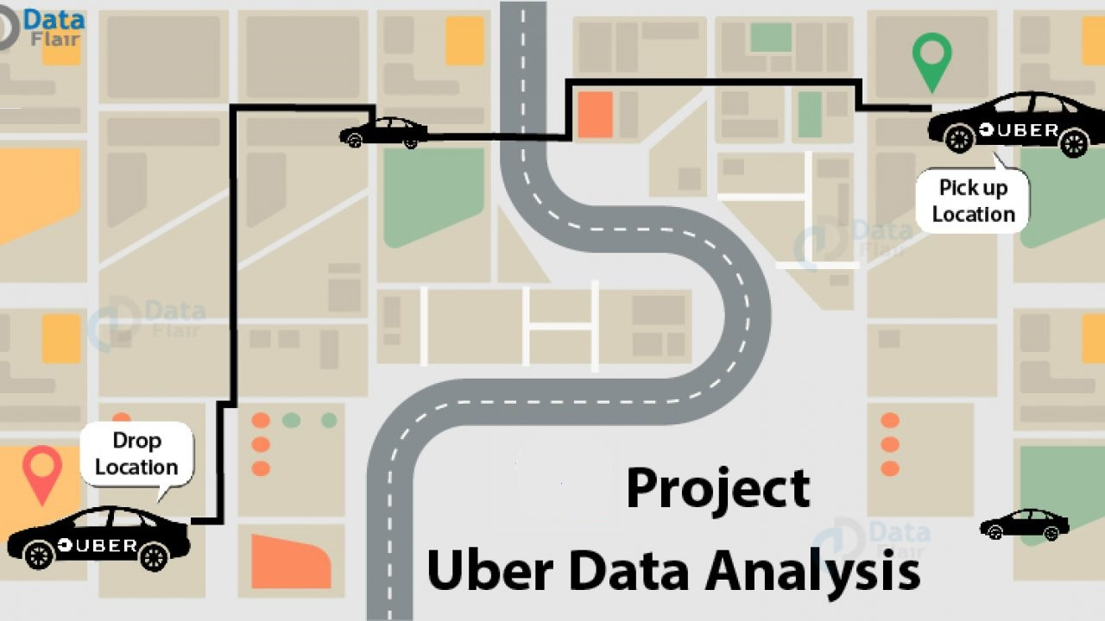

Uber Data Analysis

Slide 2
PRESENTED BY : Sowndarya A Kowshik C Soundarya S Siddhant Wange GUIDED BY : Ms. Smita

Slide 3
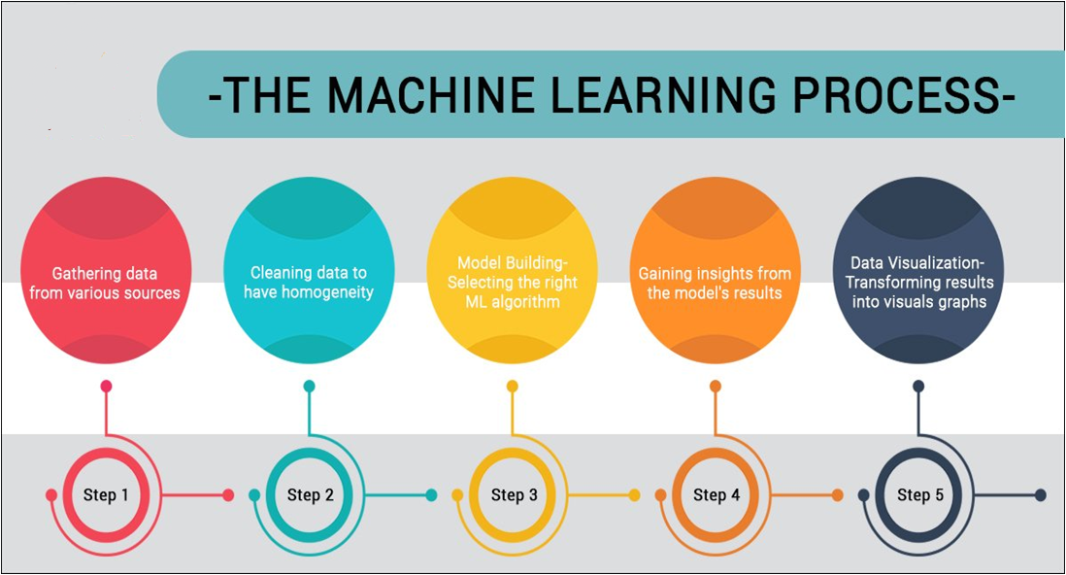

Slide 4

Aim:
Complete Data Analysis and Exploration of Uber Dataset for Uber Cab price prediction using Machine Learning Model

Slide 5



Data Set:
The Dataset is taken from Kaggle in which there are
57 Columns and approximately 6 lakh rows and the file is
In csv format.
Shape:
This project contains 693071 samples and 57 features.

Slide 6

Libraries

Slide 7

Exploratory Data Analysis
Exploratory Data Analysis refers to the criticalprocess of performing initial investigations on data soas to discover patterns to spot anomalies to test hypothesis and to check assumptions with the help of summary statistics and graphical representations.
EDA is an approach to analyzing datasets to summarize their main characteristics, often with visual methods.

Slide 8
Feature Engineering
Feature engineering or feature extraction is the process of using domain knowledge to extract features from raw data. The motivation is to use these extra features to improve the quality of results from a machine learning process, compared with supplying only the raw data to the machine learning process.
Feature engineering efforts mainly have two goals:
Preparing the proper input dataset, compatible with the machine learning algorithm requirements.
Improving the performance of machine learning models.

Slide 9
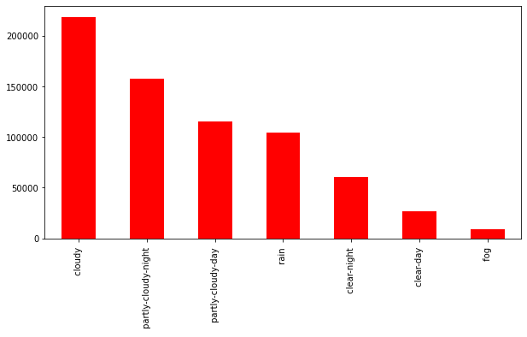
Bar plot of Icon

Slide 10
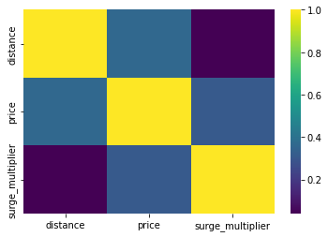
Heat map of surge_multiplier , price & distance

Slide 11
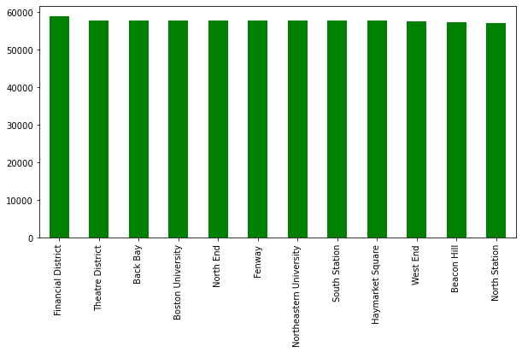
Bar plot of source column

Slide 12


Label Encoding
Label Encoding refers to converting the labels into numeric form so as to convert it into the machine-readable form. Machine learning algorithms can then decide in a better way on how those labels must be operated. It is an important pre-processing step for the structured dataset in supervised learning.

Slide 13

NANs(missing values)
Uber data set contain NANs only in Price column.
The count of nans is: 55095
The nans is filled with the median of other values.

Slide 14
Feature Selection
Feature Selection is the process of selecting a subset of relevant feature (variables, predictors) for use in model construction.
Recursive Feature Elimination
:
Recursive feature elimination (RFE) is a feature selection method that fits a model and removes the weakest feature (or features) until the specified number of features is reached.
 | A | B | C
Yellow | 10 | 20 | 7
Blue | 30 | 15 | 10
Orange | 5 | 24 | 16

Slide 15
Machine Learning models
Linear Regression: Linear Regression is a supervised machine learning algorithm where the predicted output is continuous and has a constant slope. It’s used to predict values within a continuous range.
Decision Tree: A decision tree is a graphical representation of all the possible solutions to a decision based on certain conditions.
Random Forest: Random Forest is a popular machine learning algorithm that belongs to the supervised learning technique. It can be used for both Classification and Regression problems in ML. It is based on the concept of ensemble learning, which is a process of combining multiple classifiers to solve a complex problem and to improve the performance of the model.

Slide 16
Accuracy of different featutes
After applying RFE on given data set with Linear Regression, we found accuracy with different no of columns as follows:-
Serial No. | No. of Feature | Accuracy
1 | 56 | 0.5210613019
2 | 40 | 0.52082133967
3 | 25 | 0.52068020506
4 | 15 | 0.520794445644

Slide 17
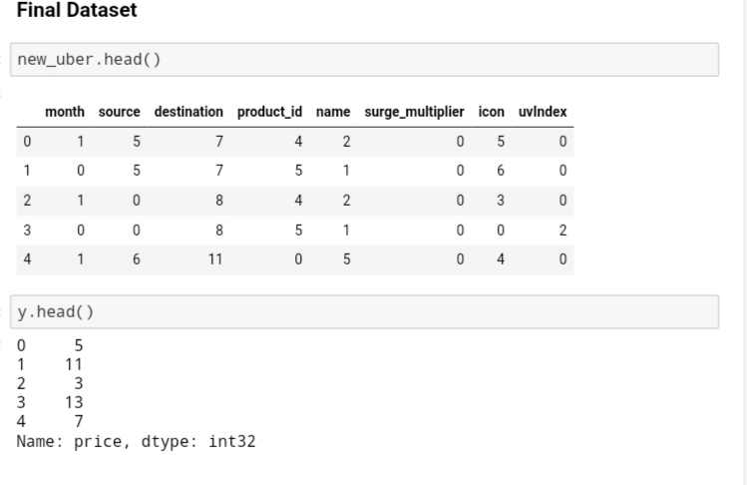
Final Dataset after EDA

Slide 18

Modeling
After Completion of Recursive Feature Elimination process, we can do Modeling on final dataset.

Slide 19
Accuracy of Machine Learning models
After applying different models on final dataset, we found different accuracy as given below :-
Serial No. | Models | Accuracy
1 | Linear Regression | 0.419808094874
2 | Decision Tree | 0.937046791248
3 | Random Forest | 0.947909325301

Slide 20
Testing
The usage of the word "testing" in relation to machine learning models is primarily used for testing the model performance in terms of accuracy/precision of the model.

Slide 21
Price Prediction Function
In this project a function is defined for price prediction which takes cab name, source, surge multiplier and icon as input and predicts the price.

Slide 22
Project Outcome
Using EDA data is analyzed.
Visualising the distribution of data & their relationships, helped us to get some insights on the feature-set.
In this project their are 693071 samples and 57 features which is reduced to 693071 samples and 25 features using RFE.
Testing multiple algorithms with default hyperparamters gave some understanding for various models performance on this specific dataset.
Random forest was the best choise as it gives more accutare result compared to other two models.

Slide 23


